Slide 1
The Standard Model of Particle physics (without any complicated math)
Michael McGinnis
michaelmcginnis2026@u.northwestern.edu

Slide 2
Expectations and goals
Ask questions

Slide 3
What is the Standard Model?
The Standard Model is the theory of elementary particles and how they interact.
17 particles, 3 interactions
Immense predictive power, including the prediction of several particles and their properties before they were discovered.
Built upon quantum field theory: combines classical mechanics, quantum mechanics, and special relativity.
Fields are the fundamental object, and particles are certain (excited) states of those fields.
Fields are objects which take a value (scalar, vector, tensor) for each point in space and time.
EX: Temperature field of this room. Gravitational field exerted by the Sun.
Model: The SM is not the truth it is a model. It is something that has been constructed under certain assumptions and can be used to make predictions but has a realm of relevance.
It works on the scale of particles but isn’t useful to understand planetary motion.

Slide 4
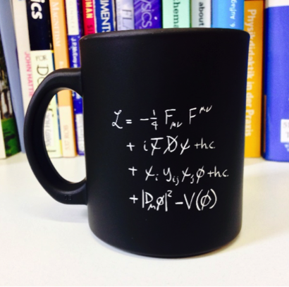
The Complicated Math
https://home.cern/news/news/cern/sit-down-coffee-standard-model#:~:text=The%20Standard%20Model%20of%20particle,t%2Dshirts%20and%20coffee%20mugs.

Slide 5
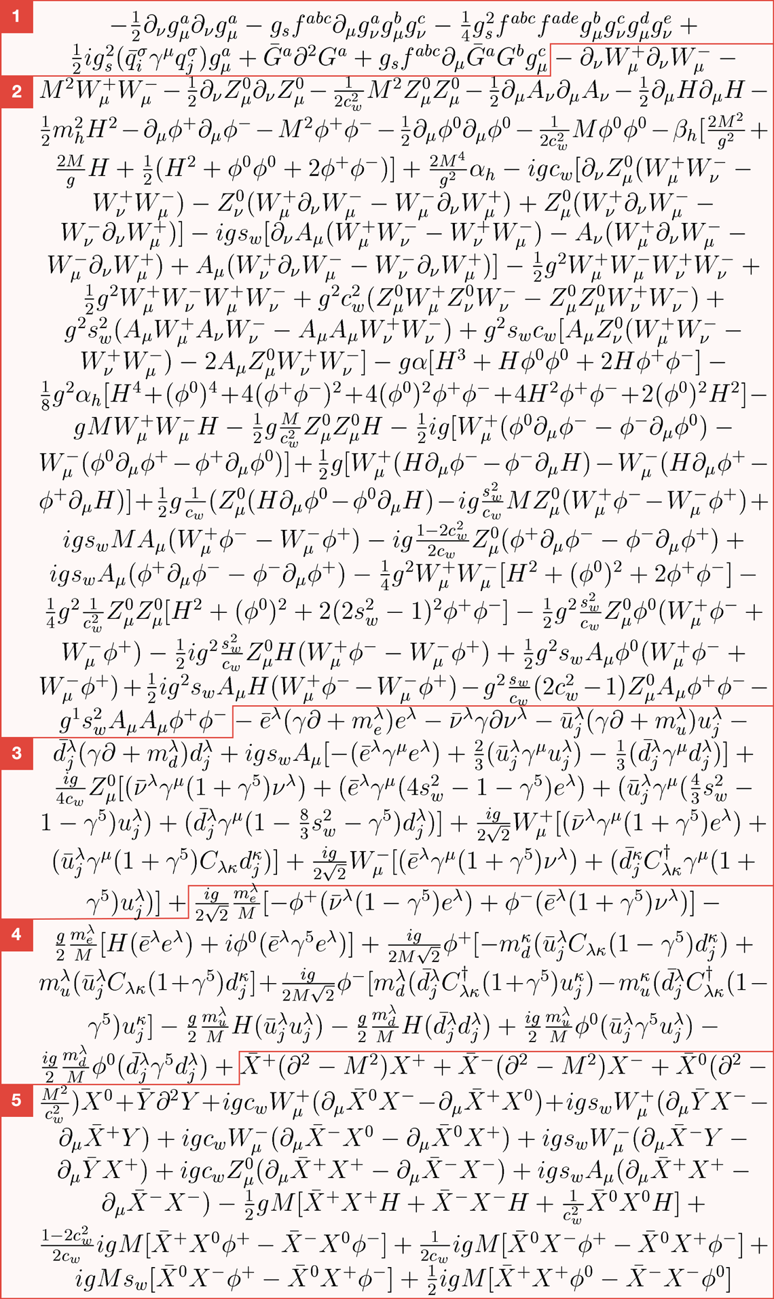
It gets worse
https://www.symmetrymagazine.org/article/the-deconstructed-standard-model-equation

Slide 6
Particles of the Standard Model

Slide 7
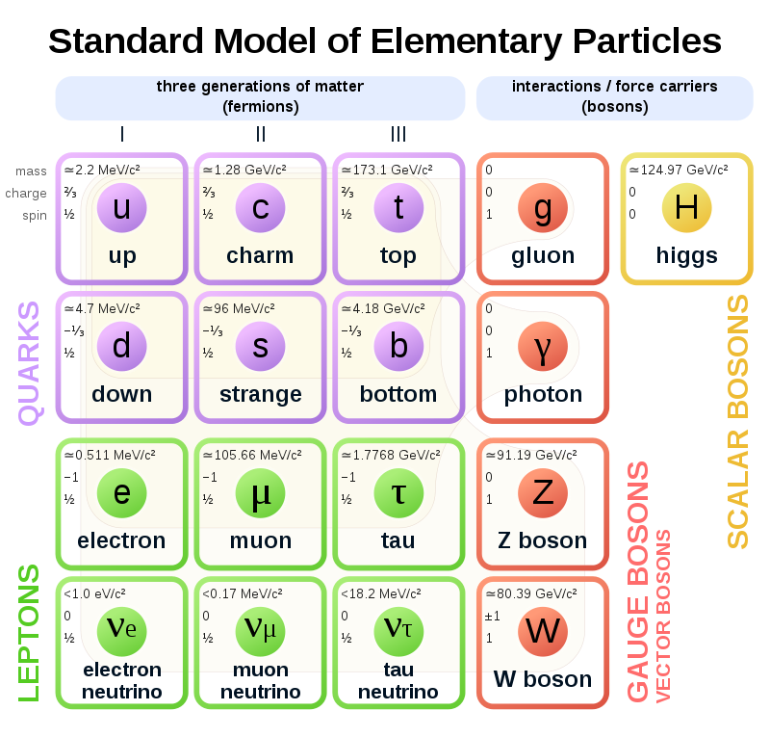
The ‘Periodic Table’
Let’s look at the numbers in each cell:
Mass (vs weight)
1 lb = 0.45 kg = 2.54×10³⁵ eV/c²
E=mc²
https://en.wikipedia.org/wiki/Standard_Model

Slide 8
The ‘Periodic Table’
Let’s look at the numbers in each cell:
Mass (vs weight)
1 lb = 0.45 kg = 2.54×10³⁵ eV/c²
E=mc²
Electric charge: interaction strength with EM

Slide 9
The ‘Periodic Table’
Let’s look at the numbers in each cell:
Mass (vs weight)
1 lb = 0.45 kg = 2.54×10³⁵ eV/c²
E=mc²
Electric charge: interaction strength with EM
Spin: intrinsic angular momentum
Not actually spinning
Chart shows total spin, can measure +/- n/2

Slide 10
Two Categories:
First, quantum numbers: numbers which specify the state particle is in: energy level, angular momentum, spin, etc.
Let's look at the spin.
**

Slide 11
Two Categories:
The particles are categorized by spin:
Fermions have spin = $\frac{n}{2}$ where n=1,2,3…
‘Fermi-Dirac Statistics’
Two fermions can’t have the same quantum numbers. This is the Pauli Exclusion Principle.
“fermions takes up space”
Boson have spin = n where n=1,2,3…
‘Bose-Einstein Statistics’
Two bosons can have the same quantum numbers.
Driving principle behind lasers: photons in the same quantum state

Slide 12
Two Categories:
Composite particles have spin equal to the sum of its parts:
A proton is composed of two up quarks and a down quark, thus has total spin 3/2.
Multiple fermions can compose bosons
Ex. Superconductivity: At certain conditions, some materials have no electrical resistance!
Two electrons form ‘Cooper Pairs.’ A pair of electrons has total spin 1, so they are bosons!
So, the pairs can occupy the lowest energy state, making resistance zero.
Spin affects the general behaviors and roles of particles

Slide 13
Bosons mediate interactions
Particle | Charge | Force | Process
gluon | Color | Strong | Holds quarks and atomic nuclei together.
photon | Electric | electromagnetic | Electricity and magnetism; light
Z, W⁺, W⁻ | Weak | Weak | Nuclear decay
Higgs | Mass | Acquisition of mass, and “electroweak symmetry breaking”
There are two types, distinguished by spin:
Scalar (spin 0): one number describes the field (magnitude)
Vector (spin 1): two numbers describe the field (magnitude and direction)
Gluons have color charge and can self-interact.
With exception of the Higgs, the other bosons do not have the charge of their respective forces.
A photon does not interact with another photon.
Higgs was the primary reason for the LHC, the discovery was announced July 4, 2012

Slide 14
3 Fermion Generations
Each column is a generation (only under fermions).
Flavor quantum number: counting each type of quark (purple).
This is conserved in some interaction
Across a row, particles differ by mass and ‘flavor quantum number.’
In general, more mass → less stable → faster decay
Higher generations decay into lower
High energy collisions required to generate higher generations (LHC, cosmic rays)
For any interaction with particles of one generation, the particles of another can be substituted.
Ex. Beta decay: $d\text{→}u+e^{−}+\overline{ν_{e}}$
$s\text{→}c+µ^{−}+\overline{ν_{µ}}$
$b\text{→}t+τ^{−}+\overline{ν_{τ}}$

Slide 15
Quarks are fermions with color charge
Interact with the strong force (gluons) because of color charge.
Also interact with EM (photon) and weak (W^{+/-}, Z) forces
For particles, color charge is red, green, or blue. Antiparticles have anti-color.
Only composite particles without color (net color charge of zero) are formed
By mixing all colors (3 quarks): baryons
EX: red up, green up, blue down: proton
By mixing a color and its anti-color (two quarks): mesons
EX: blue up, anti-blue anti-strange: Kaon
Quark confinement: the force between two quarks is constant as they are separated because gluons have color charge (vs EM). As the quarks separate the potential energy grows until it is "energetically favorable" to form new Quark antiquark pair.
Cannot observe "naked quarks“
Because of this, the way we assign colors to quarks in diagrams is mostly arbitrary.

Slide 16
Quarks also mix flavors
Quark mixing responsible for quarks of one generation to decay into another.
There is not a complete correspondence between measuring the type via the mass or weak measurements.
Measuring the mass and flavor of a quark may not give corresponding measurements.
EX: Imagine measuring both the mass and flavor of a single quark. It is possible to measure mass and get the top quark mass (173.1 GeV), then measure flavor and get down quark flavor.
It makes more sense to say that a quark has X quark mass and Y quark flavor. Usually, X=Y.
This is described by the CKM matrix. It only slightly deviates from the identity matrix (which would correspond to the measurements always being the same), so the mismatch is improbable.
$$\left[\begin{matrix}\left|V_{ud}\right| & \left|V_{us}\right| & \left|V_{ub}\right| \\ \left|V_{cd}\right| & \left|V_{cs}\right| & \left|V_{cb}\right| \\ \left|V_{td}\right| & \left|V_{ts}\right| & \left|V_{tb}\right|\end{matrix}\right]=\left[\begin{matrix}0.9743 & 0.2253 & 0.0035 \\ 0.2252 & 0.9734 & 0.0412 \\ 0.0086 & 0.0404 & 0.9991\end{matrix}\right]$$

Slide 17
Leptons are fermions without color charge
e, µ, τ interact with EM (photon) and weak (W^{+/-}, Z) forces
Neutrinos do not interact with EM, thus can only interact weakly → difficult to detect
Since they don’t interact with EM, they mostly pass through matter, as atoms are mostly empty space.
Look at your fingertip for a second

Slide 18
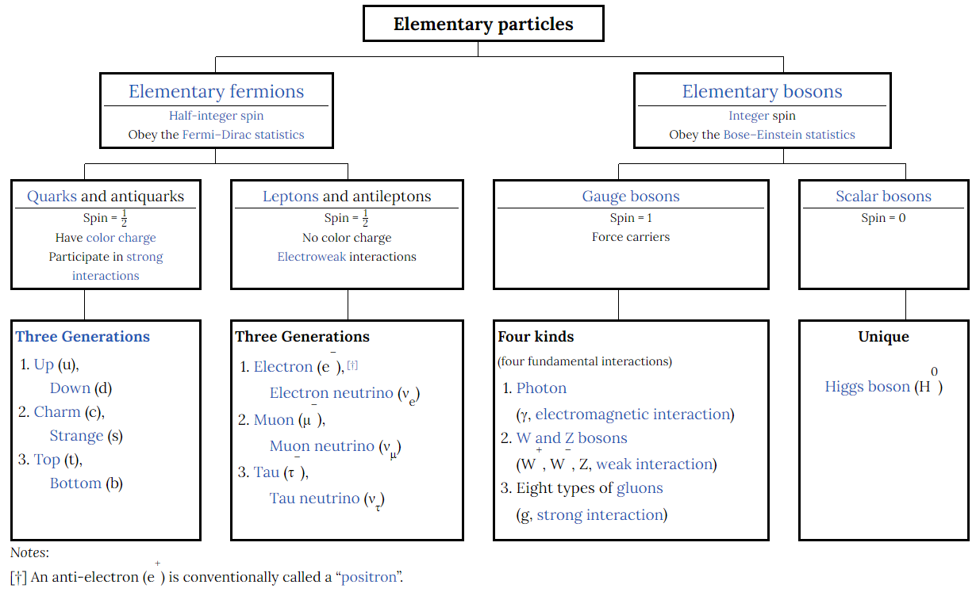
https://en.wikipedia.org/wiki/Standard_Model

Slide 19
Antimatter: same mass, spin, but opposite charges
EX: a positron/antielectron has the same mass and spin as the electron, but an electric charge of +1.
EX: the antiparticle of a red up quark is an anti-red anti-up quark (anti-red color, electric charge -2/3)
An antimatter particle is distinguished by an upper bar: positron is $\overline{e}$
Some particles are their own antiparticles, as their charges are zero: -1×0=0
Called “truly neutral”
EX: photon, Z boson, Higgs
When a matter/antimatter pair interact, they annihilate, releasing their energy.
Matter/antimatter pair can be generated from high energy bursts (not in vacuum).
Antimatter is also generated in weak decays.
Theoretical motivation comes from the Dirac equation which describes electrons with both special relativity and QM. However, it has two solutions, one for an electron with positive energy, and one with negative. Dirac took the negative energy solution to be an antielectron with +1 electric charge, so that the energy is positive. Simplify.
This is like how √4=±2 .
You have antimatter (positrons) in your body, generated by potassium-40!

Slide 20
Interactions of the Standard Model

Slide 21
Symmetry and Conservation is Central to the SM
Symmetries imply conservation laws (Noether’s theorem).
Conservation laws: of critical importance in any interaction is what doesn’t change during the process → what is conserved.
This allows us to calculate quantities in a system that changes over time.
EX: Ball falling in gravity.
Global symmetries: assumed when constructing the SM and apply to all space and time.
Time symmetry ↔ conservation of energy
You can pick t=0 to be anywhere.
Space translational symmetry ↔ conservation of linear momentum
Can pick x=0 to be anywhere.
Space rotational symmetry ↔ conservation of angular momentum
Can rotate the system any way: spherical symmetry.
Inertial reference frames ↔ special relativity
Equations of motion do not change between inertial reference frames (essentially when there is no acceleration)
You can set who is the “stationary observer.” To a car on I20, a tree appears to be moving at 70 mph. To the tree, the car is moving at 70 mph. Both are valid.

Slide 22
Symmetry and Conservation is Central to the SM
Accidental Symmetries: there are four symmetries which were not enforced when constructing the SM, but have “popped out” of it
Baryon number: baryons are particles composed of 3 quarks
This is essentially counting quarks: a quark is +1/3 and an antiquark is -1/3
$B=\frac{1}{3}\left(n_{q}−n_{\overline{q}}\right)$
Lepton (Electron/Muon/Tauon) numbers: these are the same conservation law, counting the leptons by generation. Make this clearer with pictures on slides
Each particle is +1, each antiparticle is -1
$E=\left(n_{e}−n_{\overline{e}}\right)+ \left(n_{ν_{e}}−n_{\overline{ν_{e}}}\right)$ and so on of for each generation
The SM predict that the lepton numbers are conserved separately. However, because of neutrino oscillation, the individual numbers are not conserved. Instead, they are collectively conserved: L=E+M+T

Slide 23
Three Forces are Included in the SM
In the mathematical formalism, the forces are included by imposing “gauge symmetries,” thus the same gauge boson.
The gauge symmetries correspond to the conservation of charges for each force: electric, color, and weak.
Abstract symmetry: think of every point in space in time having a little gauge (like a speedometer). For something to have a gauge symmetry, the value of these little gauges do not affect it (speedometer can be at 0, 60, or 1000 mph)
Electromagnetic, strong and weak interactions are included in the SM.

Slide 24
Electromagnetic
Electromagnetic interactions: mediated by the photon which interacts with electric charge.
Electric charge is conserved (↔gauge symmetry of the EM field)
Flavor is also conserved
To the right is a Feynman Diagram.
Two electrons interacting via a photon.
https://physicstravelguide.com/advanced_tools/feynman_diagrams

Slide 25
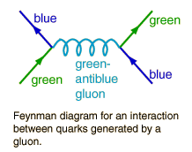
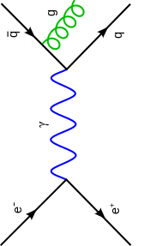
Strong
Strong/color interactions: mediated by gluons which interacts with color charge.
Everything that is observed is colorless, which is related to quark confinement.
Color charge is conserved (↔gauge symmetry of the strong/color field)
Flavor is conserved
The gluon has color charge itself, meaning it can self-interact.
Gluons have two color attributes
Responsible for forming baryons and mesons and holding atomic nuclei together.
First example shows quarks interacting via a gluon and changing color.
The second conserves color, though it may not look like it.
Emission of a gluon, changing the anti-quark’s color
http://hyperphysics.phy-astr.gsu.edu/hbase/Particles/expar.html
https://en.wikipedia.org/wiki/Feynman_diagram

Slide 26
Weak
Weak interactions: mediated by W+, W-, and Z bosons which interact with weak charge.
W+ and W- have electric charge and thus also interact electromagnetically.
Weak charge is conserved.
Flavor is NOT conserved: tend to stay in generation with leptons, but generally change generations with quarks.
Responsible for nuclear decay.
Example shows beta decay:
Charge conserved
Flavor NOT conserved: down quark to up quark
Beta decay
https://commons.wikimedia.org/wiki/File:Feynman_Diagram_-_Negative_Beta_Decay.png

Slide 27
What’s Missing? (Think about forces.) Any ideas of why?

Slide 28
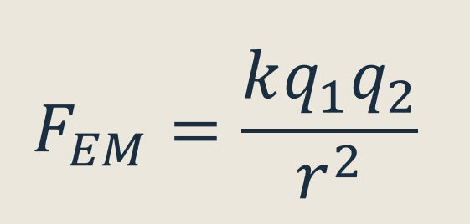
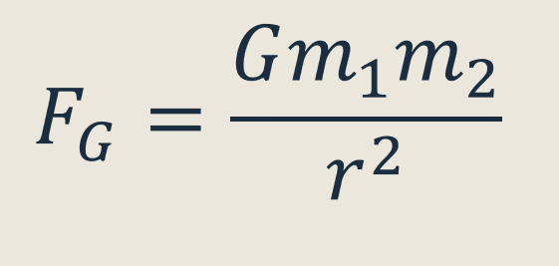
What’s Missing: Gravity
There are four fundamental forces, the three included in the SM, and gravity.
Gravity does not affect elementary particles very strongly, so it can be neglected.
Strength of gravitational fields is proportional to mass.
The mass of these particles are small compared to the electric/color/weak charges of particles
EX: electric charge of particles is ~1 and k~10¹⁰
Mass of particles is ~1 - 100 GeV/c2 ≈ 2×10⁻²⁷ - 2×10⁻²⁵ kg and G~10⁻¹¹
The strength of gravity relative to EM is predicted to be 10⁻⁴¹ for quarks and 10⁻³⁶ for protons and neutrons
The graviton, a particle mediating gravity, is predicted but there are significant problems in generating a quantum field theory for gravity.

Slide 29
The Higgs is important: why?
Some particles acquire mass through interacting with the Higgs field
Fermions also acquire mass by interacting with the Higgs, but in a different way.
Since the Higgs has mass, it interacts with itself
It decays through pair production (fermions or bosons) and productions of gluons and photons (requires and intermediate step)

Slide 30
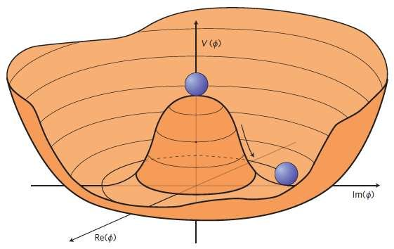
The Higgs is important: why?
Unified forces/Symmetry
It is also responsible for Electroweak Symmetry Breaking (EWSB) (the system is no longer symmetric)
In the conditions of the early universe made the forces indistinguishable: at very high energies, the EM and weak forces merge and are the same: Electroweak Symmetry.
As the universe expanded and cooled, the two forces split: symmetry breaking.
The Higgs is responsible for this. At high energies, the Higgs field does not interact, and all particles are massless. At a certain energy, the W+, W-, and Z bosons interact with the field and acquire mass, while the photon remains massless. Thus, the symmetry/unification is broken so that the EM and weak forces are distinguishable.
Separate forces/Broken Symmetry
https://www.researchgate.net/figure/A-sketch-of-Mexican-Hat-type-potential-V-ph-having-degenerate-vacuums-one-of-which-is_fig1_338549010

Slide 31
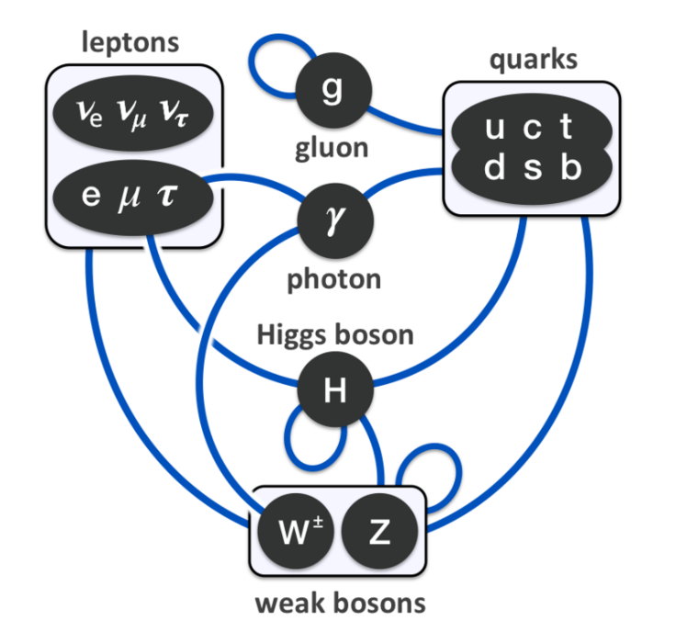
https://en.wikipedia.org/wiki/Standard_Model

Slide 32
Problems of the Standard Model

Slide 33
Unexplained Phenomena
Gravity
Neutrinos are assumed massless in the SM, but it has been discovered that they do. Consequences of them having mass:
Like quarks mass and flavor measurements do not always correspond to each other.
EX. It is possible to measure the mass and flavor of a neutrino and get the electron-neutrino mass and muon-neutrino flavor.
vs. an electron will always have a rest mass of 0.511 MeV
Neutrino oscillation: a neutrino can be emitted as one type but measured as another because it oscillates between the three states.
Dark matter: does not interact with light, accounts for ~85% of the mass of the universe
Dark energy: about 69% of the energy of the universe is undetected
Matter/antimatter symmetry: the SM predicts that they were created in equal amounts when matter was forming in the early universe. So, there must be a mechanism to break this symmetry, but the SM does not include one.

Slide 34
Unexplained Experimental Results
Theoretical Problems
Anomalous magnetic dipole moment of the muon (muon “g-2”): this is used to measure the strength of a magnetic source and depends on loops in Feynman diagrams. The measured value for the muon differs significantly from SM predictions.
B meson decay: B mesons are composed of b ̅ and u,d,s or c quarks. There is a decay that has been measured to occur significantly more than the SM predicts.
Why are there 19 numerical parameters?
Is it possible to construct a quantum field theory with the scalar Higgs?
Hierarchy problem: Why is the Higgs mass what it is?

Slide 35
Some cool links
3D CERN event viewer: http://opendata.cern.ch/visualise/events/cms#
Feynman diagram cheat sheet: https://indico.cern.ch/event/570855/contributions/2315633/attachments/1497945/2331732/CheatSheet.pdf
Interactive periodic table of elementary particles: http://www.thingsmadethinkable.com/item/elementary_particles.php
How to build your own particle detector: https://www.symmetrymagazine.org/article/january-2015/how-to-build-your-own-particle-detector

Slide 36
Questions?
Suggestions: Feynman diagrams, Noether’s theorem, the LHC

